Slide 1
Data Mining: Theory & Algorithms
Lecturer: Dr. Bo Yuan
E-mail: yuanb@sz.tsinghua.edu.cn

Slide 2



Slide 3


Slide 4
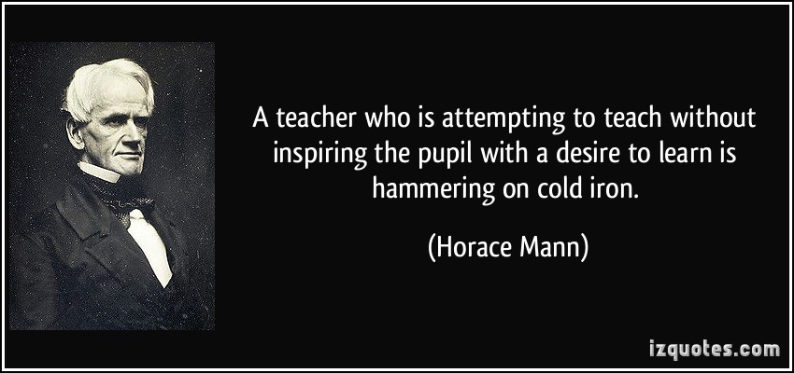

Slide 5
Mining? Warehousing?

Slide 6
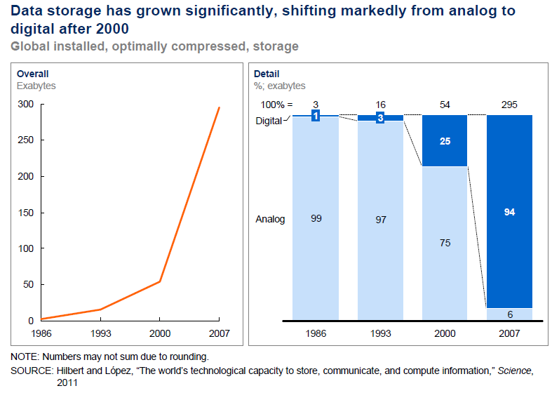
Technology Advancement

Slide 7
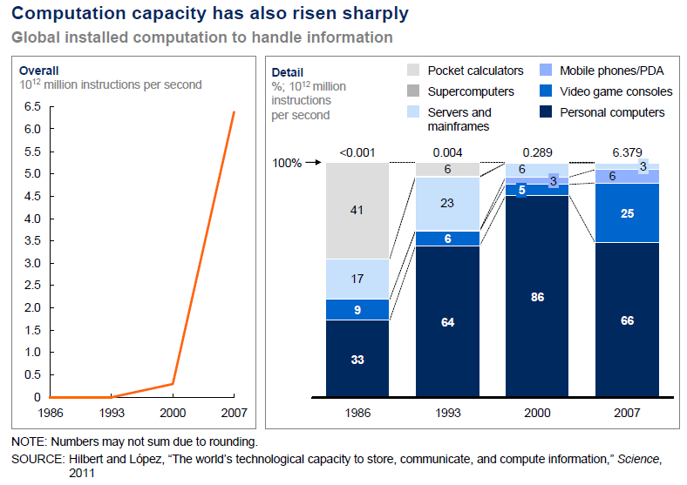
Technology Advancement

Slide 8




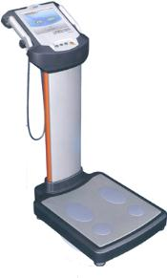
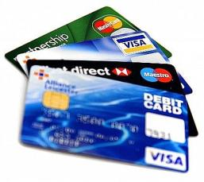
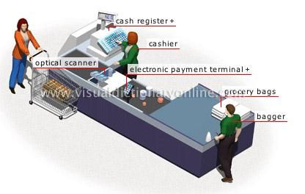
The World of Data

Slide 9
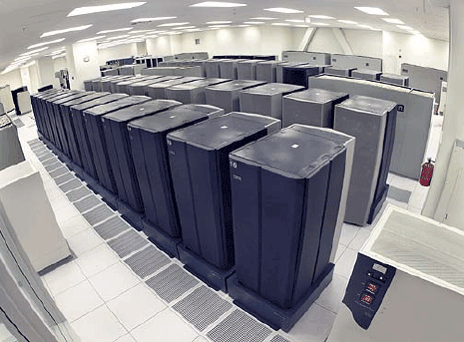

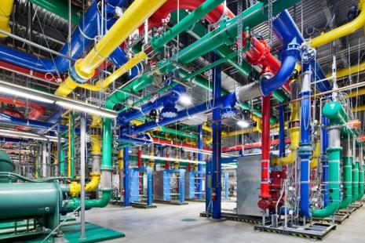
Data Rich, Information Poor
Notes:
The global data supply reached 2.8 zettabytes (ZB) in 2012 - or 2.8 trillion GB - but just 0.5% of this is used for analysis, according to the Digital Universe Study.
http://www.guardian.co.uk/news/datablog/2012/dec/19/big-data-study-digital-universe-global-volume

Slide 10


Slide 11
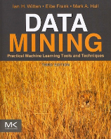
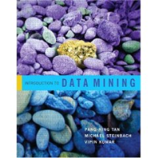
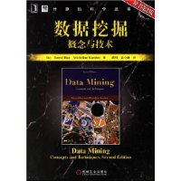


Learning Resources
International Conference on Data Mining
International Conference on Data Engineering
International Conference on Machine Learning
International Joint Conference on Artificial Intelligence
Pacific-Asia Conference on Knowledge Discovery and Data Mining
ACM SIGKDD Conference on Knowledge Discovery and Data Mining

Slide 12

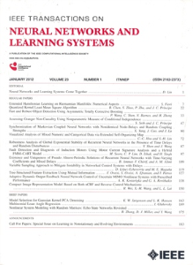
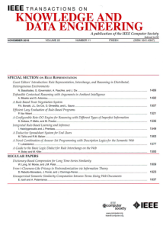



Learning Resources

Slide 13








Learning Resources
Xindong Wu
Zhihua Zhou
Jiawei Han
Jian Pei
Qiang Yang
Chih-Jen Lin
Philip S. Yu
Changshui Zhang

Slide 14







Learning Resources

Slide 15
Interdisciplinary
Data Mining
Machine Learning
Pattern Recognition
Statistics
Artificial Intelligence

Slide 16
Ubiquitous
Data Mining
Business Intelligence
Data Analytics
Customer Relationship Management
Decision Support
Big Data

Slide 17
Comprehensive Learning
Class Teaching
Thinking
Reading Materials
Extension
Inspiration
Practice
Techniques
Applications
Discussion

Slide 18

Learning ≠ Listening

Slide 19
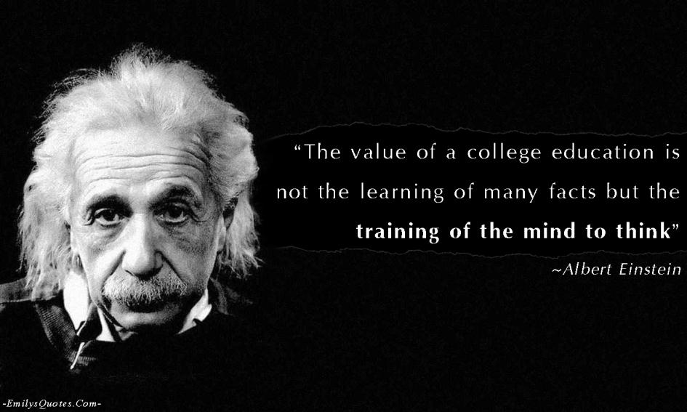

Slide 21



Data
Definition
“Data are pieces of information that represent the qualitative or quantitative attributes of a variable or set of variables. Data are often viewed as the lowest level of abstraction from which information and knowledge are derived.”
Data Types
Continuous, Binary
Discrete, String
Symbolic
Storage
Physical
Logical
Major Issues
Transformation
Errors and Corruption

Slide 22


What is Big Data?
“Big data is high-volume, high-velocity and high-variety information assets that demand cost-effective, innovative forms of information processing for enhanced insight and decision making.” — Gartner
“Big data refers to datasets whose size is beyond the ability of typical database software tools to capture, store, manage, and analyze.” — Mckinsey & Company
Notes:
http://www.gartner.com/it-glossary/big-data/
http://www.mckinsey.com/insights/business_technology/big_data_the_next_frontier_for_innovation

Slide 23
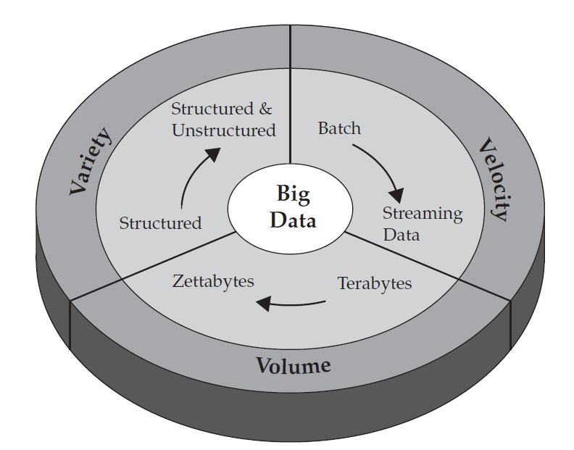
Big Data

Slide 24
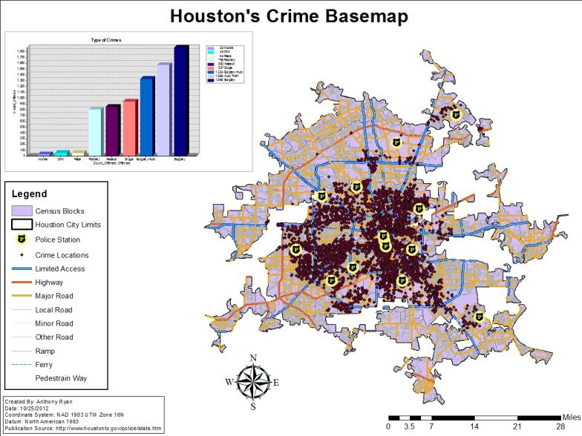
Public Security

Slide 25

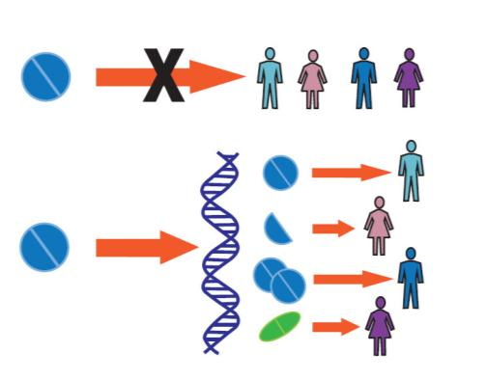
Health Care Application
Personalized Medicine
Effectiveness Research
Notes:
1. Effectiveness research.
Many studies have shown that wide variations exist in health care practices, outcomes, and costs across different providers, geographies, and patients. Critically analyzing large datasets that include patient characteristics and the cost and outcomes of treatments can help to identify the most clinically effective and cost-effective treatments to apply. There is potential to reduce incidences of overtreatment—i.e., interventions that do more harm than good—and undertreatment—cases in which a specific therapy should have been prescribed but was not. Both overtreatment and undertreatment result in worse patient outcomes and higher health care costs in the long run.
2. Clinical decision support systems.
By deploying these systems, providers can reduce adverse reactions and lower treatment error rates and liability claims, especially those arising from clinical mistakes. In the future, big data systems such as these can become substantially more intelligent by including modules that use image analysis and recognition in databases of medical images (X-ray, CT, MRI) for prediagnosis or that automatically mine medical literature to create a medical expertise database capable of suggesting treatment options to physicians based on patients’ medical records.

Slide 26

Location Data: Urban Planning

Slide 27
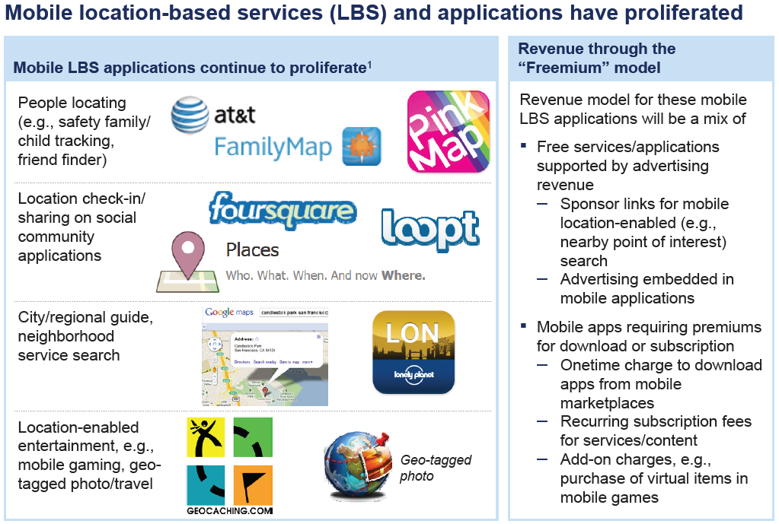
Location Data: Mobile User

Slide 28
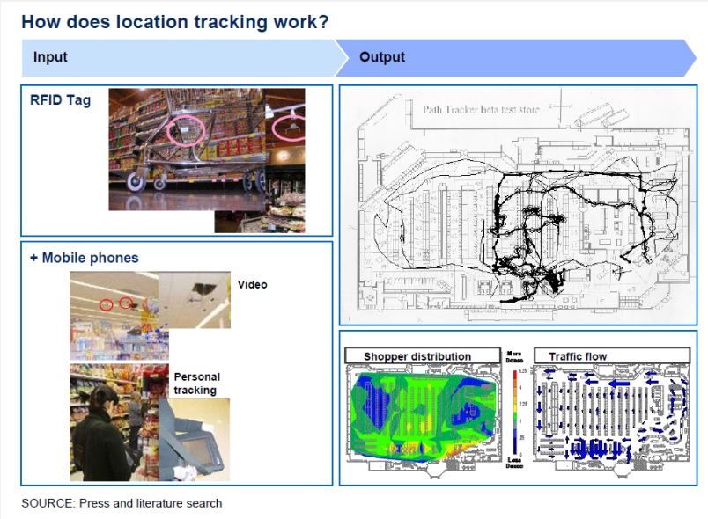
Location Data: Shopper

Slide 29

Retail Data: Targeted Marketing

Slide 30


Retail Data: Sentiment Analysis
Notes:
Sentiment analysis leverages the voluminous streams of data generated by consumers in the various forms of social media to help inform a variety of business decisions. For example, retailers can use sentiment analysis to gauge the real-time response to marketing campaigns and adjust course accordingly. The evolving field of social media data analysis plays a key role because consumers are relying increasingly on peer sentiment and recommendations to make purchasing decisions. A variety of tools has emerged for the real-time monitoring and response to Web-based consumer behavior and choices.

Slide 31

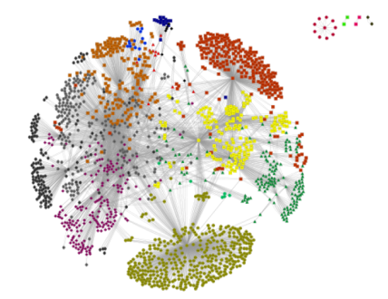
Social Networks

Slide 32




Sports

Slide 33
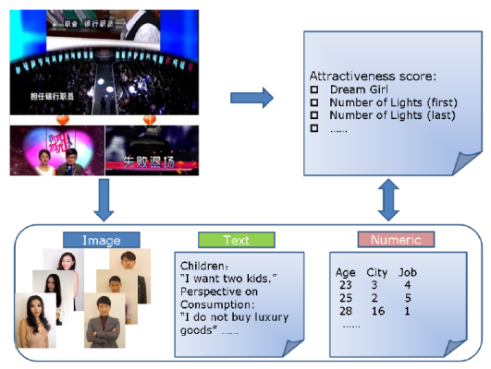
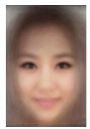

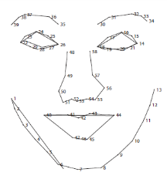
Attractiveness Mining

Slide 35
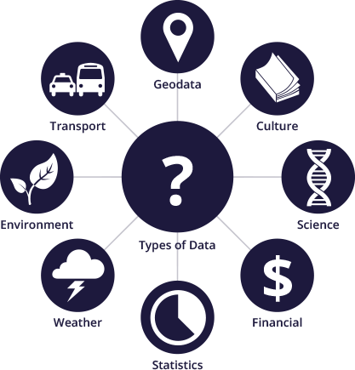
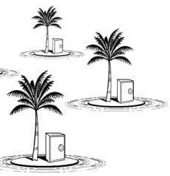
Open Data
Technically Open: available in a machine-readable standard format, which means it can be retrieved and meaningfully processed by a computer application.
Legally Open: explicitly licensed in a way that permits commercial and non-commercial use without restrictions.
Notes:
http://data.worldbank.org/about/open-government-data-toolkit/knowledge-repository
http://theodi.org/

Slide 36
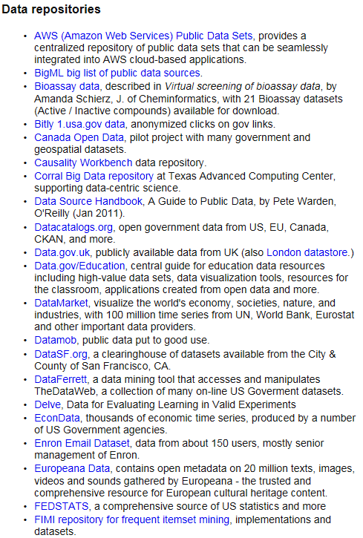
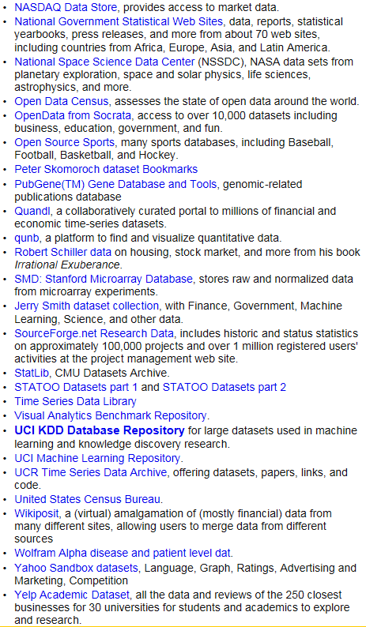
Where to find data?
Notes:
http://www.kdnuggets.com/datasets/index.html

Slide 37
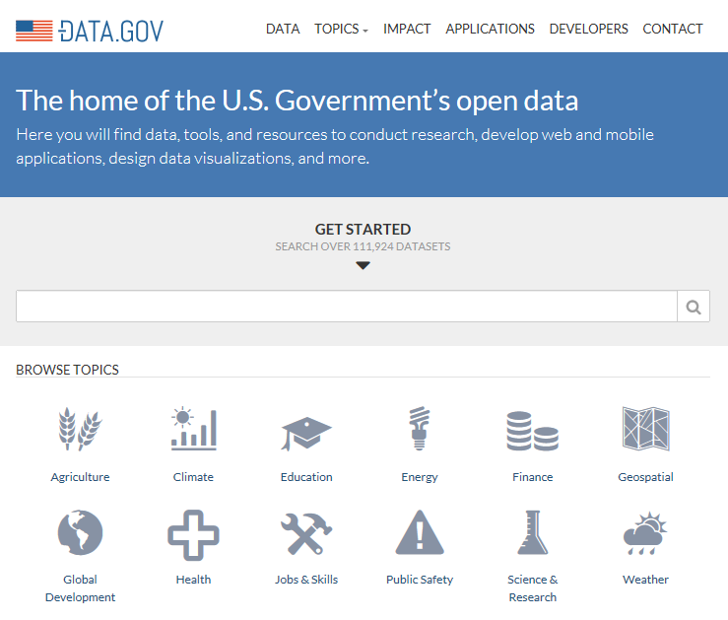
Open Government Data

Slide 38
Data Mining
People have been analysing and investigating data for centuries.
Statistics
Mean, Variance, Correlation, Distribution …
In modern days, data are often far beyond human comprehension.
Diversity, Volume, Dimensionality
Definition
Data Mining is the process of automatically extracting interesting and useful hidden patterns from usually massive, incomplete and noisy data.
Not a fully automatic process
Human interventions are often inevitable.
Domain Knowledge
Data Collection and Pre-processing
Synonym: Knowledge Discovery

Slide 39

Is DM really important?
“If you are looking for a career where your services will be in high demand, you should find something where you provide a scarce, complementary service to something that is getting ubiquitous and cheap. So what’s getting ubiquitous and cheap? Data. And what is complementary to data? Analysis. So my recommendation is to take lots of courses about how to manipulate and analyze data: databases, machine learning, econometrics, statistics, visualization, and so on.”
An interview with Google Chief Economist
Hal Varian from the New York Times

Slide 40
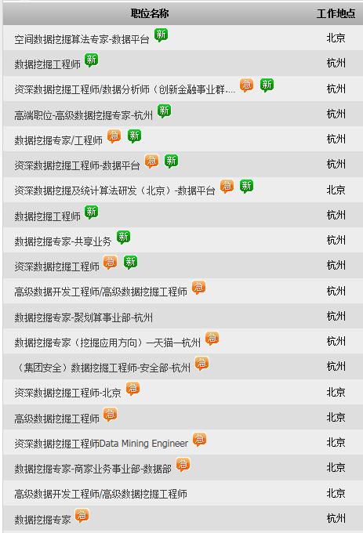

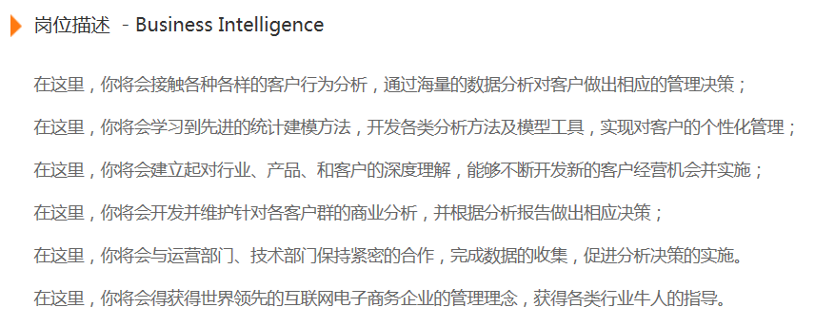

Slide 41

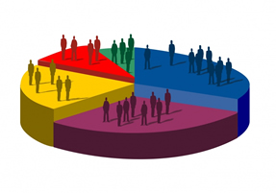


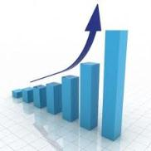
Business Intelligence

Slide 42
From Data To Intelligence
Decision Models
Decision Support
Data Mining
Knowledge
Preprocessing
Information
Database
Data

Slide 43
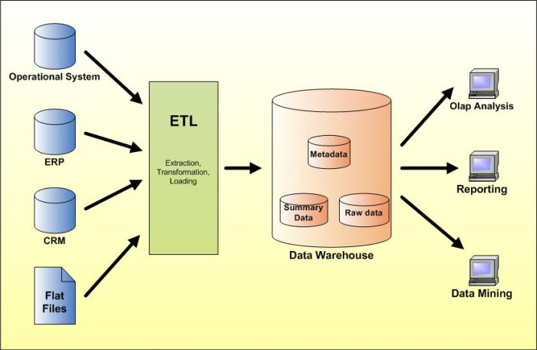
Data Integration & Analysis

Slide 44
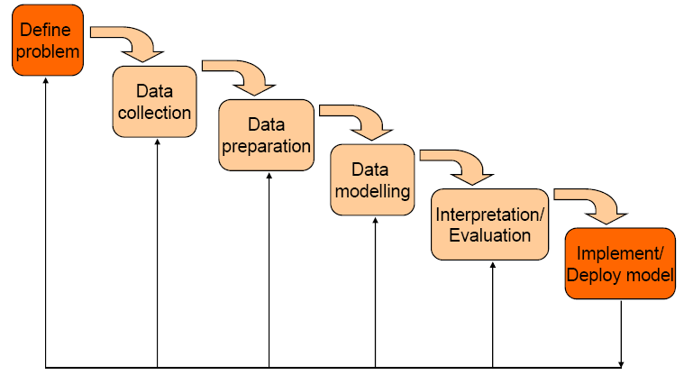
The Process of Data Mining

Slide 45
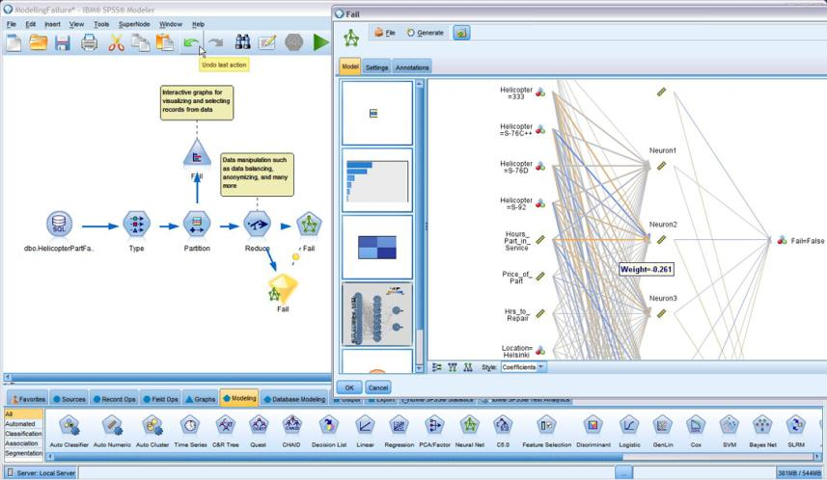
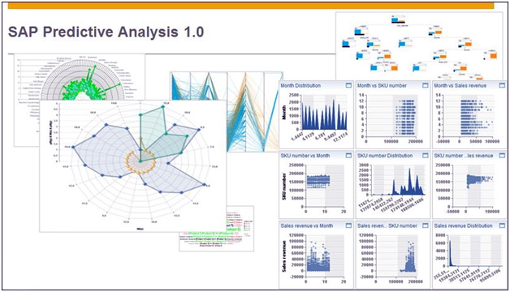

Slide 46
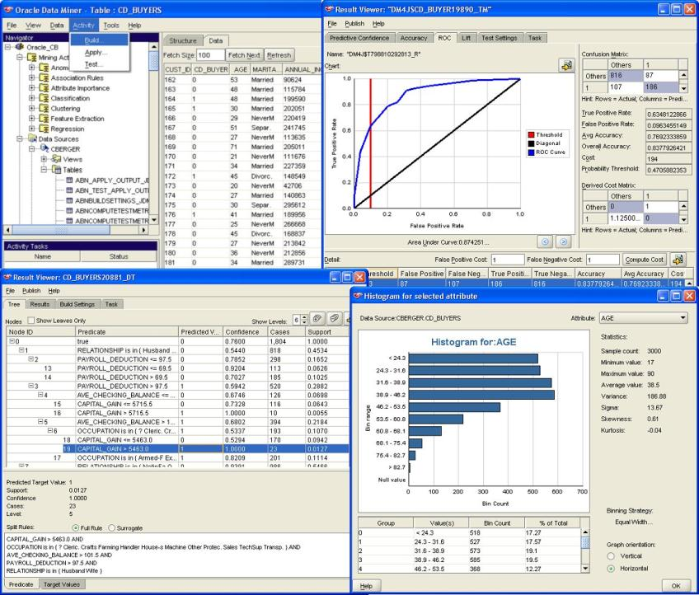

Slide 48

DM Techniques - Classification
“Classification is a procedure in which individual items are placed into groups based on quantitative information on one or more characteristics (referred to as variables) and based on a training set of previously labeled items.”
Given a training set: {(x₁, y₁), …, (x_{n}, y_{n})}, produce a classifier (function) that maps any unknown object x_{i} to its class label y_{i}.
Algorithms
Decision Trees
K-Nearest Neighbours
Neural Networks
Support Vector Machines
Applications
Churn Prediction
Medical Diagnosis
X
Y

Slide 49
Classification Boundaries
Low Risk
?
Savings
Y
High Risk
?
Income
X

Slide 50

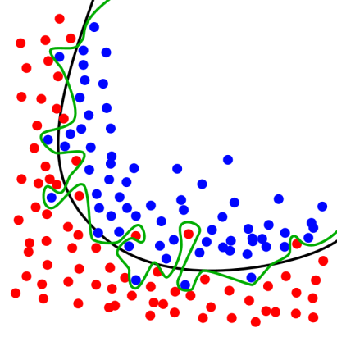
Overfitting – Classification

Slide 51
Cross Validation
Training Set
Generated Models
Data
Evaluation
Test Set

Slide 52
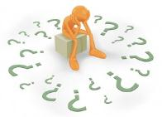
Confusion Matrix
Confusion Matrix
 |  | Actual Value
 |  | Positive | Negative | Total
Predicted Value | Positive | True Positive | False Positive | P'
 | Negative | False Negative | True Negative | N'
Total |  | P | N
TPR=TP/(TP+FN)
TNR=TN/(TN+FP)
Accuracy=(TP+TN)/(P+N)

Slide 53
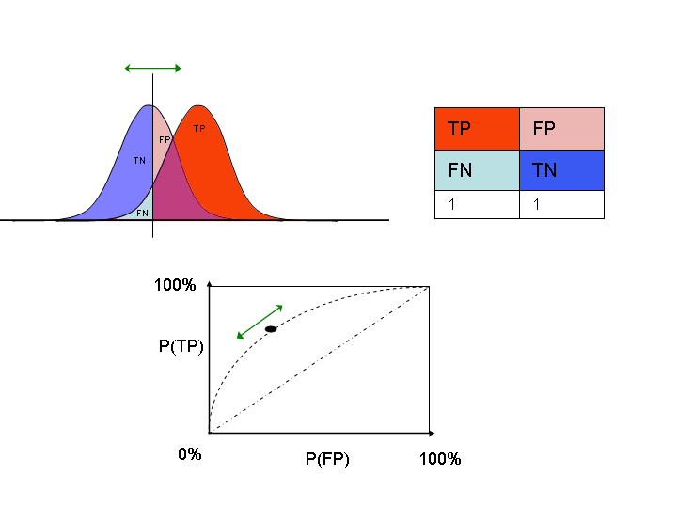
Receiver Operating Characteristic
Very small threshold
Very large threshold
Random guess

Slide 54




Cost Sensitive Learning

Slide 55
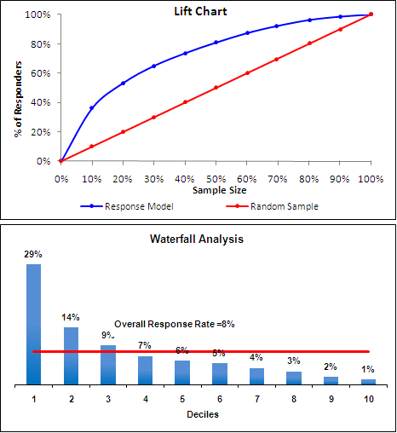


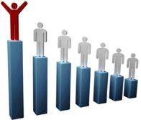
Lift Analysis

Slide 57
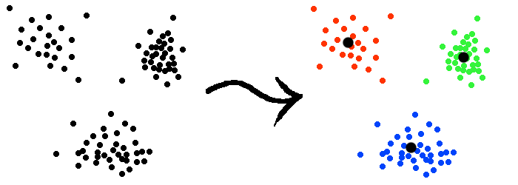
DM Techniques - Clustering
“Clustering is the assignment of a set of observations into subsets (called clusters) so that observations in the same cluster are similar in some sense.”
Distance Metrics
Euclidean Distance
Manhattan Distance
Mahalanobis Distance
Algorithms
K-Means
Sequential Leader
Affinity Propagation
Applications
Market Research
Image Segmentation
Social Network Analysis
What is the difference between classification and clustering?

Slide 58
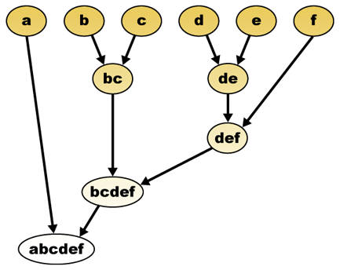
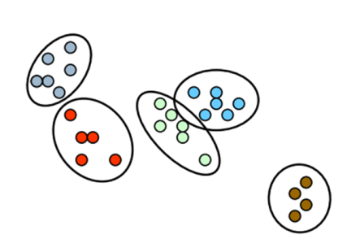
Hierarchical Clustering

Slide 59

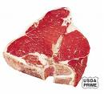

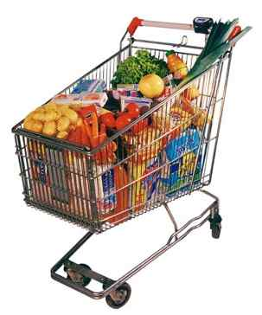




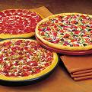

DM Techniques – Association Rule

Slide 60
Association Rule
Transaction ID | Milk | Bread | Butter | Beer
1 | 1 | 1 | 0 | 0
2 | 0 | 1 | 1 | 0
3 | 0 | 0 | 0 | 1
4 | 1 | 1 | 1 | 0
5 | 0 | 1 | 0 | 0

Slide 61
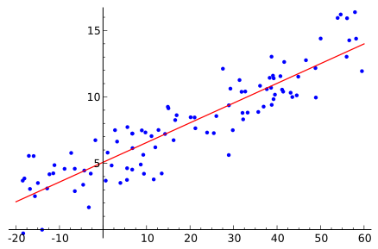
DM Techniques – Regression

Slide 62
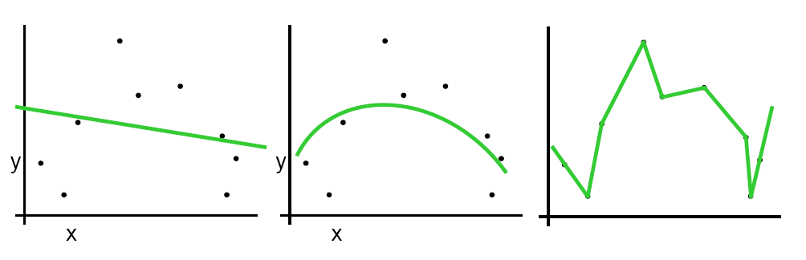
Overfitting – Regression
y
x

Slide 63

Seeing is Knowing

Slide 64

Performance Dashboard

Slide 65

Notes:
http://selection.datavisualization.ch/

Slide 66


Data Preprocessing
Real data are often surprisingly dirty.
A Major Challenge for Data Mining
Typical Issues
Missing Attribute Values
Different Coding/Naming Schemes
Infeasible Values
Inconsistent Data
Outliers
Data Quality
Accuracy
Completeness
Consistency
Interpretability
Credibility
Timeliness

Slide 67


Data Preprocessing
Data Cleaning
Fill in missing values.
Correct inconsistent data.
Identify outliers and noisy data.
Data Integration
Combine data from different sources.
Data Transformation
Normalization
Aggregation
Type Conversion
Data Reduction
Feature Selection
Sampling

Slide 69

Internet Privacy

Slide 70


Slide 71

Privacy Protection
Data: A Double-Edged Sword
People can benefit greatly from data analysis.
The consequence of information leakage can be catastrophic.
People may be reluctant to give sensitive information due to privacy concerns.
Drug, Tax, Sexuality …
How to find out the percentage of people with a certain attribute?
The interviewer should not know the true answer of each respondent.
Randomized Response
Used in structured survey research.
Can maintain the confidentiality of respondents.

Slide 72

Privacy Protection
Two questions are presented:
Q1: I have the attribute A.
Q2: I do not have the attribute A.
The respondent uses a random device to:
Answer Q1 with probability p.
Answer Q2 with probability 1-p.
The interviewer has no idea about which question is answered.
Notes:
P*(True) is the proportion of the “True” responses in the survey.
P(True) and P(False) are the true proportions of the “True” and “False” responses to the sensitive question (Q1).
P(False)=1-P(True)

Slide 73



Cloud Computing

Slide 74





Cloud Computing
Pay As You Go
Software as a Service
Platform as a Service
Infrastructure as a Service

Slide 75





Parallel Computing

Slide 76





Parallel Computing

Slide 77

Notes:
http://www.ebay.com/itm/2013-Best-Gaming-PC-SLINKY-SUPERCOMPUTER-Nvidia-GeForce-GTX-TITAN-Quad-SLI-/300905943892

Slide 78

Mobile Supercomputing

Slide 79



Intel MIC
Notes:
http://www.intel.com/content/www/us/en/processors/xeon/xeon-phi-coprocessor-overview.html

Slide 80





The Big Picture

Slide 81

No Free Lunch
Why bother so many different algorithms?
No algorithm is always superior to others.
No parameter setting is optimal over all problems.
Look for the best match between problem and algorithm.
Experience
Trial and Error
Factors to consider:
Applicability
Computational Complexity
Interpretability
Always start with simple ones.

Slide 83

Just in Case Someone Asks …

Slide 84

Just in Case Someone Asks …

Slide 85

Grouping
Group A
Group B
Y
X

Slide 86
Violent Crime vs. Video Game
Notes:
Video game sales: in billion US dollars
Crime in the United States by Volume and Rate per 100,000 Inhabitants
http://en.wikipedia.org/wiki/Crime_in_the_United_States
http://www.healthline.com/health-news/video-games-saints-or-psychopaths-082814
Does Media Violence Predict Societal Violence? It Depends on What You Look at and When
Christopher J. Ferguson
Journal of Communication doi:10.1111/jcom.12129

Slide 87


Tricky?
Is there correlation between height and business success?
Average American Male is 5’9’’.
Only 3.9% adult American men are taller than 6’2”.
Around 30% CEOs of Fortune 500 are taller than 6’2’’.

Slide 88


Survivorship Bias

Slide 89


这是真的吗？
Notes:
《淘宝大数据》 p.30

Slide 90


时间去哪儿了？

Slide 91




